Slide 1


The Chilly Dog Group Members Grant Franklin Martin Rennaker Yarentzy Magallanes Sponsor Skyelar Head TA Sambandh Dhal

Slide 2
Project Overview
Problem statement
A car parked outside on a sunny, 95-degree day can reach temperatures of up to 117 degrees Fahrenheit in just 30 minutes.
Approximately 100 dogs die in vehicles from heat exhaustion according to the AVMA.
Solution
Provide ideal cabin conditions to allow your pet to safely stay unattended in a vehicle.
Notes:
***You stop at the store just to run in for a second, and leave your pet in the car with the windows “cracked.” You’re just going to grab a couple of things, so it should all be fine. However, the lines in the store are long, you found a few extra things you needed, and you ran into your neighbor and chatted for a few. Your pet should still be okay, though… he’s only been out there for about 20-30 minutes. Right?
Wrong.
***A car parked outside on a sunny, 95-degree Fahrenheit day can reach temperatures of up to 117 degrees Fahrenheit in just 30 minutes.
Your quick trip to the grocery store could be the determining factor between your pets life or death.
**approximatley 100 dogs die from heat exhaustion according to the American Veterinary Medical Association.
***We, the chilly dogs, have created a device to keep your cabin cool while you are away and assure the safety of your pet.
***The chilly dog is a battery powered car A/C system. that can cool the inside of your vehicle without relying on the motor of your car or its battery.
***Chilly Dog users will be able to adjust the desired output temperature using a phone application and even recive alerts when conditions become unfit for the pet.

Slide 3
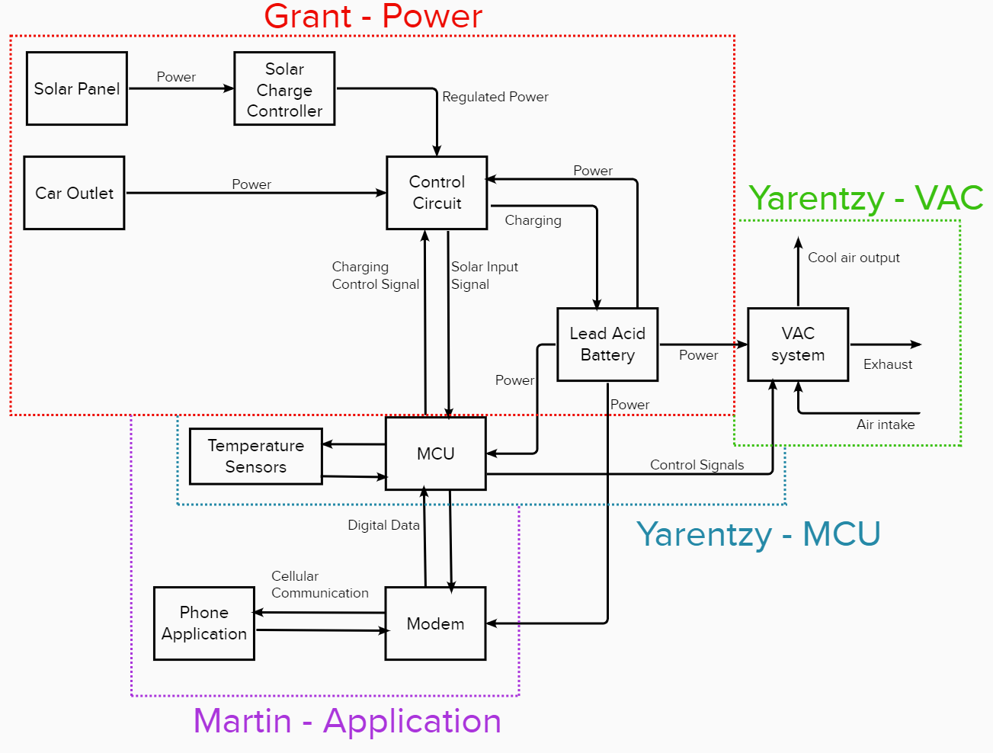
Subsystem Block Diagram

Slide 4
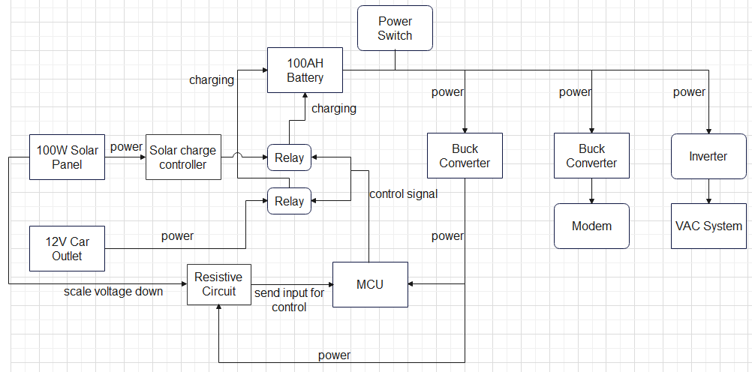
Power Supply Progress
Accomplishments since last presentation​ 15 hrs | Ongoing progress and plans until the next presentation​
Validated the functionality of the inverter and VAC system using a 12V input​ as well as solar panel output Designed, simulated and ordered parts for the solar voltage circuit | Finalize circuits, simulate, and order Buck converter parts Receiving parts and testing the Solar Voltage and Buck circuits​ Testing solid state relays for the other part of the charging control circuit​ Creating, ordering, and testing PCB design for full circuit​

Slide 5
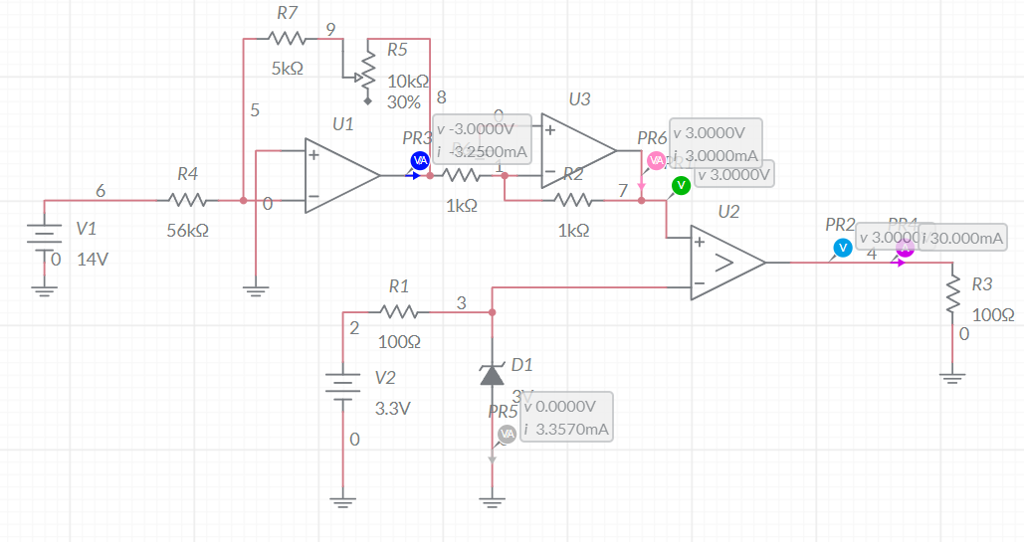
Solar Voltage Circuit

Slide 6
Progress VAC
Accomplishments since last presentation​​ 1 hrs | Ongoing progress and plans until the next presentation​​
Tested and recorded minimum and maximum temperature ranges Verified modes of operation | Record power consumption in each mode Obtain access to the powering of the AC
Maximum Temp Output: 75 degrees F
Minimum Temp Output: 62 degrees F

Slide 7
Progress MCU
Accomplishments since last presentation​​ 15 hrs | Ongoing progress and plans until the next presentation​​
Digital Output Digital Input Configure and control digital I/O pins Timer using polling Timer using interrupts | ADC Input Voltage to temperature calculations Reading ambient temperature with MCU
Notes:
Turn on LED (proves I can configure output and set pins as either high or low)
Blink LED (proves I can select the internal oscillator frequency as well as using delays)
Read switches (proves I can read digital inputs, use conditional branching, use internal pull ups, and switch debouncing)
Timer using polling
Timer using interrupts
ADC Input

Slide 8
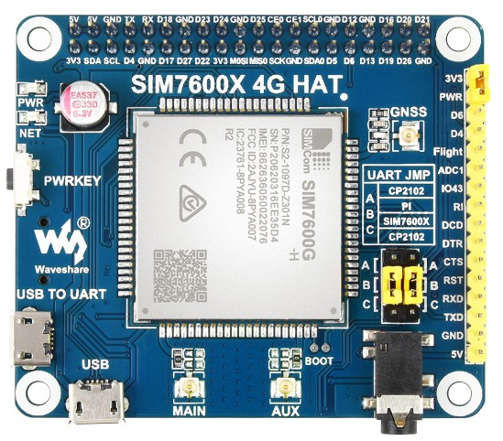
Modem 5 hrs
Modem Updates:
Realized that 2G and 3G towers have been/are being taken down
Switching to a Waveshare SIM7600A-H pi hat and pi to manage cellular modem interface, ran out of time searching for a more compact solution and this is a little overkill but will do the job well
Setup pi to be ready for the hat to come in
Modem Updates:
Connect to Pi and send a text message to any phone
Write a program to take input from MCU and send correctly formatted text to app
Receive text from app and format data to send to MCU
The Waveshare 7600A-H

Slide 9
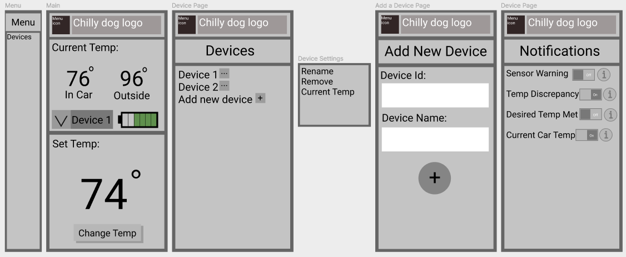
Phone Application 15 hrs
Phone App Updates:
Updated the UI design to include notifications
Successfully made an app that can send a text and receive a text
Phone App Immediate Future:
Implement with modem and send a text between the two
Make a system to distinguish the different notifications from the device to the app
Send notifications from the app to the phone.
An updated mock-up of the app

Slide 10
Validation Plan – Power Supply and Application
Item Testing | Success Criteria | Methodology | Status | Responsible Engineer(s)
Battery Output | The battery will output a DC voltage of +12V for the 1.3 hours of run time. | Set up a dummy load for the full system and see if the battery can power it for an extended amount of time. | Untested | Grant Franklin
MCU Input | The +12V DC from the battery will be stepped down to 5V for the temperature controlling MCU system. | Create an input voltage and current that mimics the battery and use a multimeter to assure that the output of the Buck converter is 5V. | Untested | Grant Franklin
Modem Input | The +12V DC from the battery will be stepped down to 5V for the modem. | Create an input voltage and current that mimics the battery and use a multimeter to assure that the output of the Buck converter is 5V. | Untested | Grant Franklin
Inverter Output | The inverter correctly changes the +12V DC from the battery to 110V AC that will route to the VAC. | Create an input voltage and current that mimics the battery and use a multimeter to assure that the output of the inverter is an AC 110-115V. | Untested | Grant Franklin
Solar Panel Charging | The mounted solar panel will provide sufficient charging for the battery at ~14V. | Use a multimeter to check that power coming from the solar panel and solar charge controller is a DC 14V. | Untested | Grant Franklin
12V Outlet Charging | The +12V DC from the car outlet will provide sufficient charging for the battery at ~14V. | Use a multimeter to check that power coming from the 12V car outlet is a DC 14V when the car is on. | Untested | Grant Franklin
Input Power Switching | The switchover circuit will be able to correctly choose which power source to use. | When the solar panel is supposed to be routing power to the battery, use a multimeter to assure voltage is flowing in the correct place. Repeat for the 12V car outlet | Untested | Grant Franklin
Data Receiving | The App can successfully send temp data to the modem and the modem will output(digitally) the correct temp | Change the desired temp in the app and, using an oscilloscope, measure the digital output and see if it matches the sent temperature. | Untested | Martin Rennaker
Data Transmitting | The Modem can successfully transmit current in car temp, outside temp, and current battery life to the app. App is displaying sent numbers | Generate a digital signal matching an expected temperature and battery % and see if the app reflects the sent signals. | Untested | Martin Rennaker
Transmit Time | The modem and app can send the 16 required bits in under 5 seconds | The app will record the exact time the signal leaves and connected to a computer, we will record the exact time the signal arrives. | Untested | Martin Rennaker
Transmit Distance | The modem and app can communicate at 500 yards apart vial cellular data | Walk 500 yards from the modem and send a signal to be received. | Untested | Martin Rennaker
Notification | The device will notify the user via popup banner if the battery drops below 15% | Send a battery life signal of less than 15% and see if the app sends a popup banner to the phone. | Untested | Martin Rennaker
Modem Power | The modem's power consumption will not exceed the 5V at 50 mA | Will use a multimeter to verify | Untested | Martin Rennaker

Slide 11
Validation Plan – MCU/VAC
VAC Cooling Specifications | The VAC's minimum temperature output is 62 degrees Fahrenheit | VAC unit will be placed in a crossover vehicle and data of the maximum cooling capacity capability will be collected | Untested
Ventilation | The VAC shall operate while maintaining sufficient oxygen (at least 20%) in the cabin of the vehicle. | The VAC will be placed inside the vehicle with the exhaust | Untested
VAC Power Consumption | Accurate Data of the power consumption corresponding to each mode (Low, Med, High) | An electricity usage monitor power meter plug outlet will be used to measure the power consumption corresponding to each mode of the VAC unit. | Untested
Temperature Sensor | Both temperature sensors report the same measurement | Redundancy will assure accuracy. Two temperature probes will be taking ambient readings. A comparison of these inputs will assure functionality. | Untested
MCU Communication with VAC | The MCU has full functionality and control of the VAC unit. (On, Off, Low, Med, High, Temperature Output) | Test cases for each functionality as well as expected outputs will be programmed and tested. | Untested
MCU Data Receiving | The MCU can receive the user setpoint from the application as well as the battery percentage | Generate expected digital signal of setpoint temperature and battery percentage display received data. | Untested
MCU Data Transmitting | The MCU shall output temperature readings to be received by the application | Temperature will be read using the probes and interpreted into digital signals to them be outputted. | Untested
Measurement Periods | The MCU shall receive and output the temperature to the application every 60 seconds | A stopwatch will be used to measure frequency of reading and outputs. | Untested

Slide 12
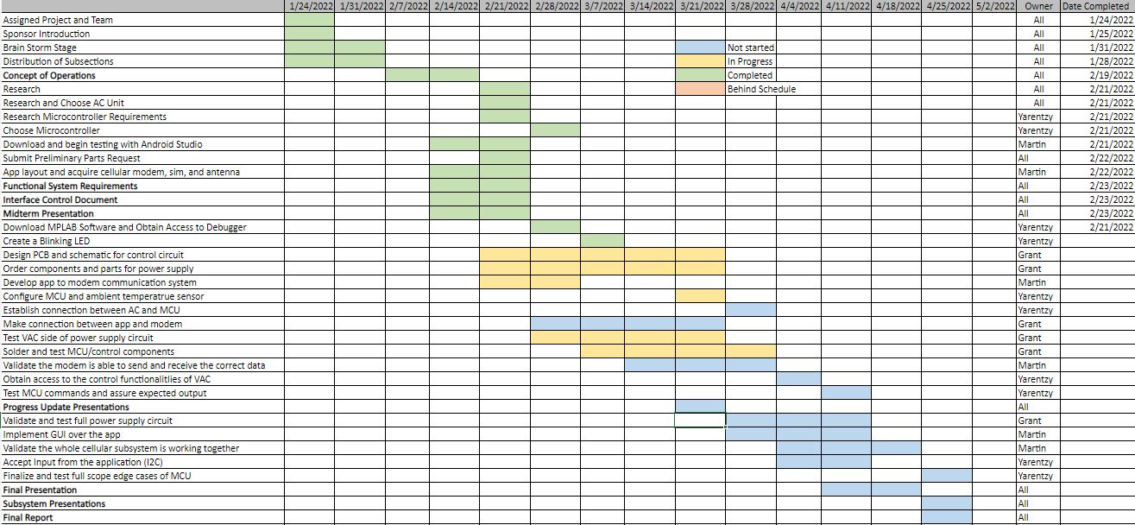
Execution Timeline

Slide 13

Questions?

